Slide 1
Craft Beer observations

Slide 2

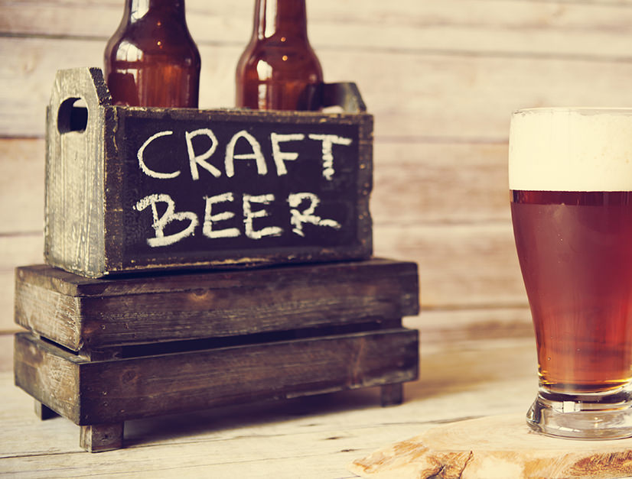
the data
2,305 unique beers
an Alcohol by Volume (ABV) measurement
An International Bitterness Unit (IBU) measurement
100 styles of beer
50 states and territories
We focused on those within the mainland U.S.
384 different cities

Slide 3
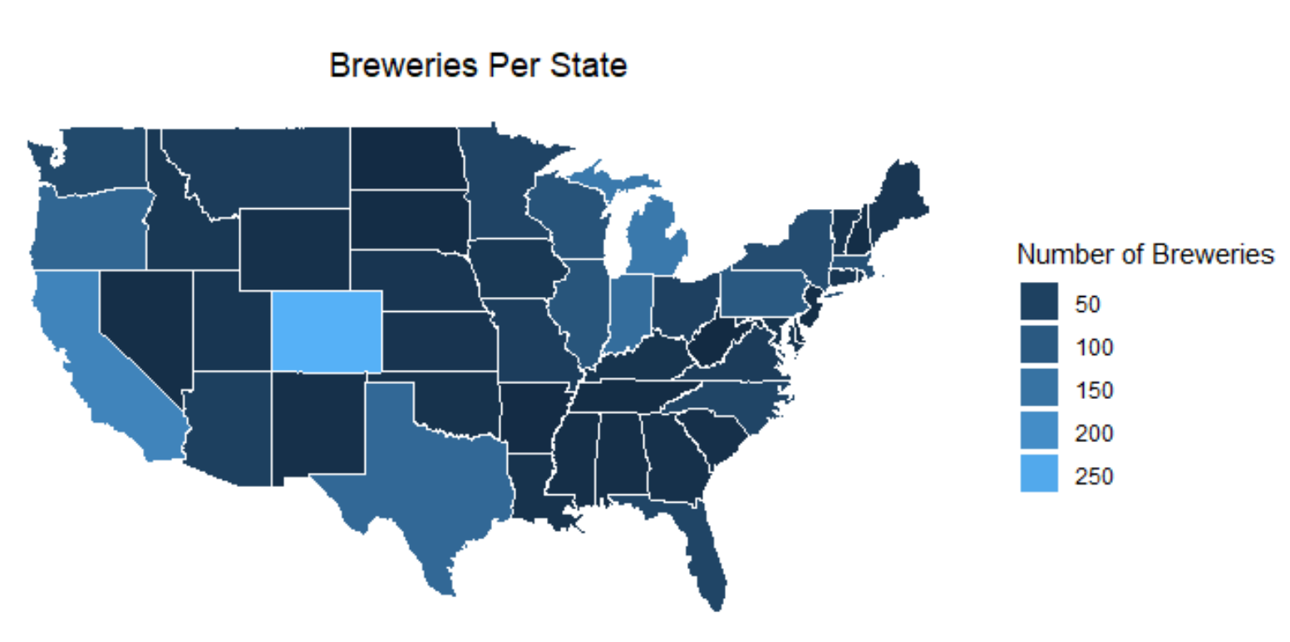
Breweries per state
Colorado clearly wins
Other states with large numbers of craft breweries:
California
Texas
Michigan
Indiana
These states may have large numbers of breweries because they have larger populations

Slide 4
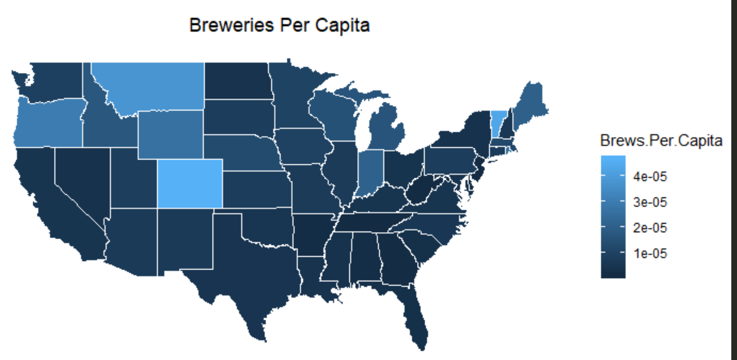
Where are craft breweries most competitive?
Colorado still leads
Colorado residents clearly support craft breweries!
Other states with large numbers of craft breweries:
Vermont
Montana
Oregon
Wyoming

Slide 5
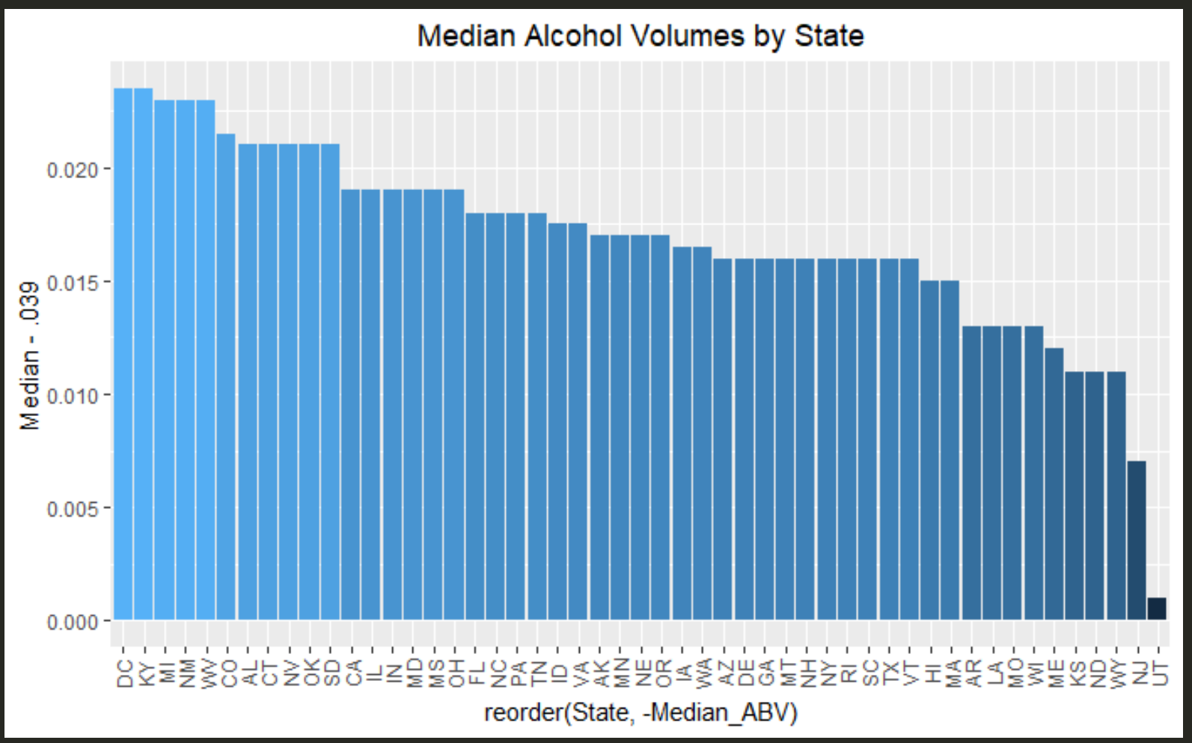
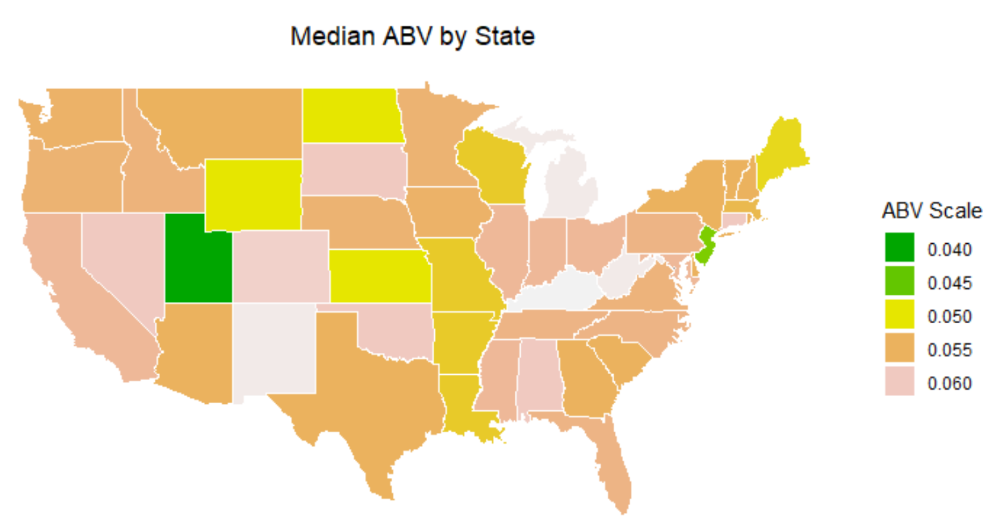
Alcohol Content
Highest alcohol content
Washington, DC
Kentucky
Michigan
Lowest alcohol content
Wyoming
New Jersey
Utah

Slide 6
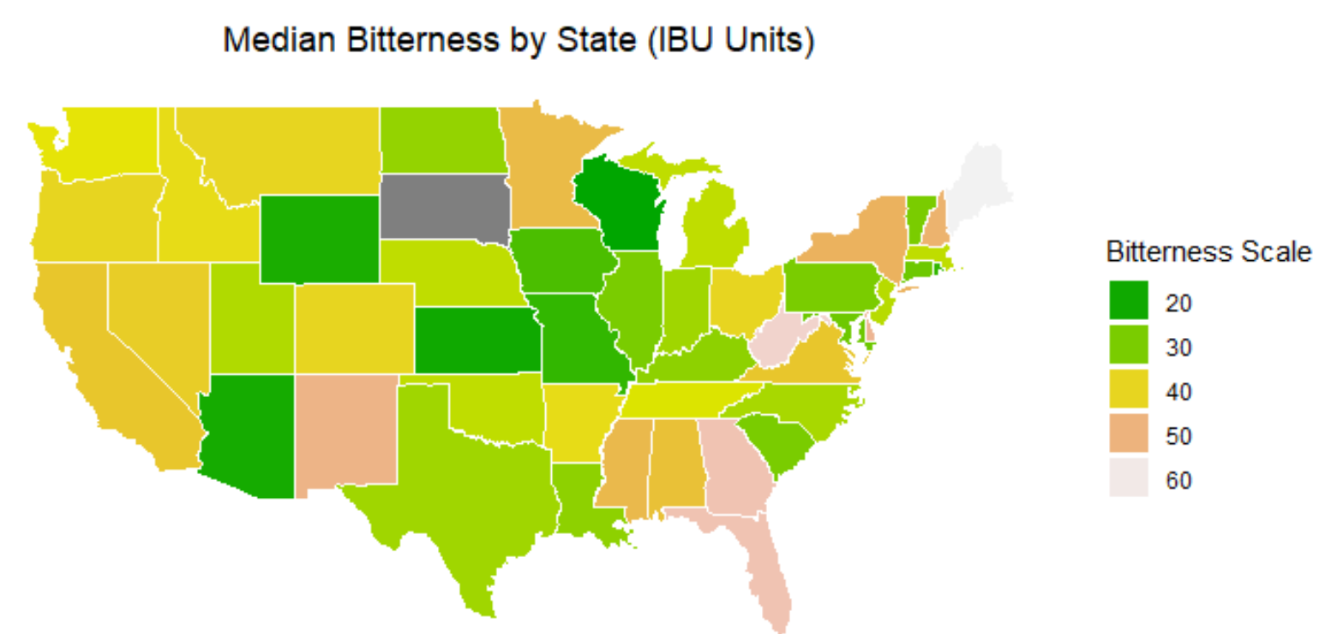
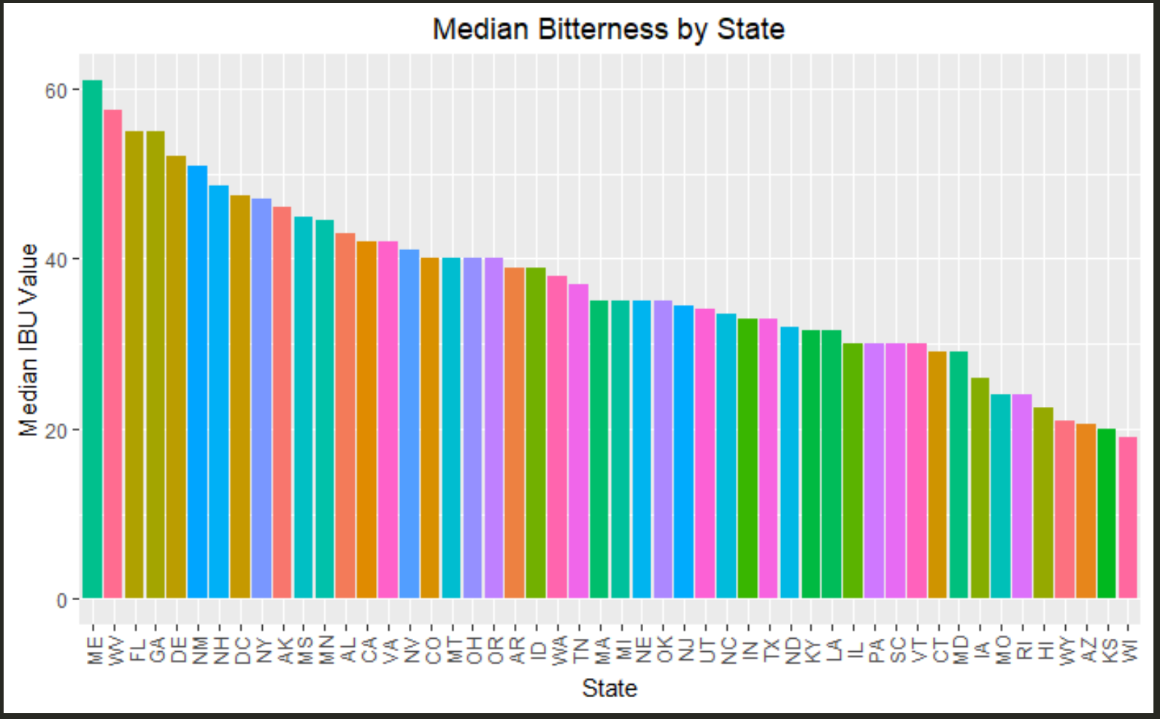
Bitterness
Most Bitter
Maine
West Virginia
Florida
Least Bitter
Wisconsin
Kansas
Arizona

Slide 7
Regional taste preferences
Midwestern states prefer lower median bitterness than other regions.
West Coast breweries appear to consistently produce beers in the medium bitterness range
Bitterness varies widely on the East Coast.
The East Coast does contain 3 of the states with the highest median bitterness
North Dakota is grey?
No bitterness ratings were available from breweries in that state.

Slide 8
Conclusions
Hard to make definitive conclusions
44% beers have no reported bitterness (1005 out of 2305)
breweries that have reported their bitterness ratings may have a significant influence on the available data.
wide variance among states (except for the West Coast)
breweries specializing in bitter beers make a significant impact on the dataset
could be significantly impacting the taste preferences of their entire state.

Slide 9
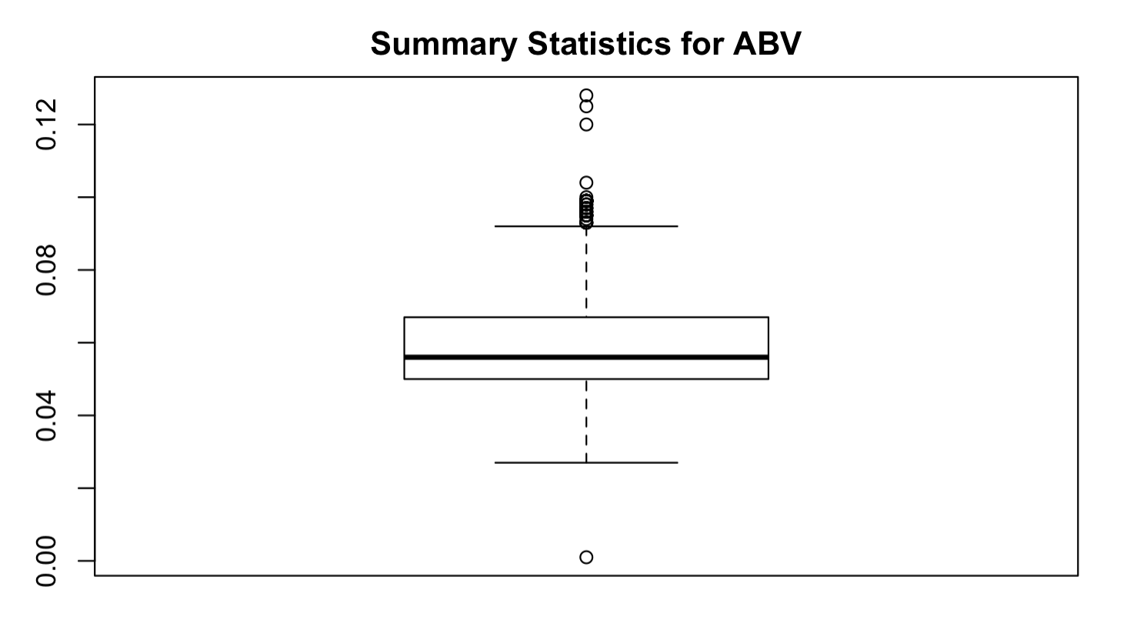
Summary Statistics for ABV
Min. | 1st Qu. | Median | Mean | 3rd Qu. | Max. | NA’s
0.00100 | 0.05000 | 0.05600 | 0.5977 | 0.6700 | 0.12800 | 62

Slide 10
Maximum alcohol content
MAXIMUM ABV
LOCATION:
BOULDER, COLORADO
ABV:
.128
BEER NAME:
LEE HILL SERIES VOL. 5
BREWERY NAME:
UPSLOPE BREWING COMPANY
BEER STYLE:
BELGIAN STYLE QUADRUPEL ALE

Slide 11
MAXIMUM BITTERNESS (IBU)
MAXIMUM IBU
LOCATION:
ASTORIA, OR
ibu:
138
BEER NAME:
BITTER BITCH IMPERIAL IPA
BREWERY NAME:
ASTORIA BREWING COMPANY
BEER STYLE:
American Double / Imperial IPA

Slide 12
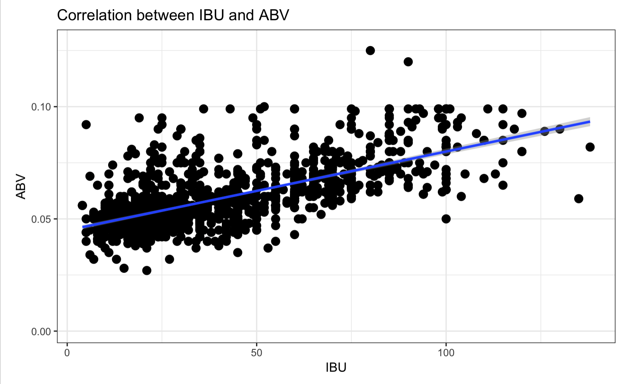
Positive Correlation between bitterness and alcohol content

Slide 13
Parallels
The maps also indicate a correlation between median bitterness and alcohol content
State laws limiting alcohol content have an impact on median bitterness from state to state
States that restrict alcohol content of beer will tend to have lower median IBU

Slide 14
Craft Beer observations
Justin howard
Justinhoward@mail.smu.edu
Amber burnett
aburnett@mail.smu.edu

Slide 15
the data
2,305 unique beers
an Alcohol by Volume (ABV) measurement
An International Bitterness Unit (IBU) measurement
100 styles of beer
50 states and territories
We focused on those within the mainland U.S.
384 different cities

Slide 16
Breweries per state
Colorado clearly wins
Other states with large numbers of craft breweries:
California
Texas
Michigan
Indiana
These states may have large numbers of breweries because they have larger populations

Slide 17
Where are craft breweries most competitive?
Colorado still leads
Colorado residents clearly support craft breweries!
Other states with large numbers of craft breweries:
Vermont
Montana
Oregon
Wyoming

Slide 18
Alcohol Content
Highest alcohol content
Washington, DC
Kentucky
Michigan
Lowest alcohol content
Wyoming
New Jersey
Utah

Slide 19
Bitterness
Most Bitter
Maine
West Virginia
Florida
Least Bitter
Wisconsin
Kansas
Arizona

Slide 20
Regional taste preferences
Midwestern states prefer lower median bitterness than other regions.
West Coast breweries appear to consistently produce beers in the medium bitterness range
Bitterness varies widely on the East Coast.
The East Coast does contain 3 of the states with the highest median bitterness
North Dakota is grey?
No bitterness ratings were available from breweries in that state.

Slide 21
Conclusions
Hard to make definitive conclusions
44% beers have no reported bitterness (1005 out of 2305)
breweries that have reported their bitterness ratings may have a significant influence on the available data.
wide variance among states (except for the West Coast)
breweries specializing in bitter beers make a significant impact on the dataset
could be significantly impacting the taste preferences of their entire state.

Slide 22
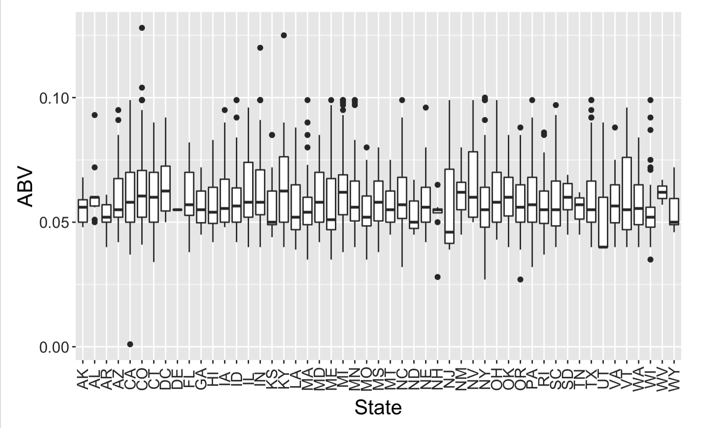
Summary Statistics for ABV
Min. | 1st Qu. | Median | Mean | 3rd Qu. | Max. | NA’s
0.00100 | 0.05000 | 0.05600 | 0.05977 | 0.06700 | 0.12800 | 62

Slide 23
Maximum alcohol content
MAXIMUM ABV
LOCATION:
BOULDER, COLORADO
ABV:
.128
BEER NAME:
LEE HILL SERIES VOL. 5
BREWERY NAME:
UPSLOPE BREWING COMPANY
BEER STYLE:
BELGIAN STYLE QUADRUPEL ALE

Slide 24
MAXIMUM BITTERNESS (IBU)
MAXIMUM IBU
LOCATION:
ASTORIA, OR
ibu:
138
BEER NAME:
BITTER BITCH IMPERIAL IPA
BREWERY NAME:
ASTORIA BREWING COMPANY
BEER STYLE:
American Double / Imperial IPA

Slide 25
Possible Correlation between bitterness and alcohol content

Slide 26
Parallels
The maps also indicate a correlation between median bitterness and alcohol content
State laws limiting alcohol content have an impact on median bitterness from state to state
States that restrict alcohol content of beer will tend to have lower median IBU

Slide 27
Thank you.
Questions?

